Slide 1
Fast Convergence Page Rank in Hadoop
Geet Varma – gmv33
Joseph Bernard – jkb243
Sudharsan Premkumar – sc2466

Slide 2
Reducer Input and outputs
Inputs
<;v, PR(v), deg(v), [u1, u2, …] >
<u,v> - BE edges
<u,v,r> - BC edges
Emit
<v; PR(v), deg(v), [u1, u2, ….] >

Slide 3
Reducer Data Structures
Input key value map - { v : <v, PR(v), deg(v), [u1, u2,…]> }
Page rank at beginning of pass – { v : PR(v) }
BE edges Map – { v : [u1, u2,…] }
BC edges Map – { v : [R1, R2,…] }

Slide 4
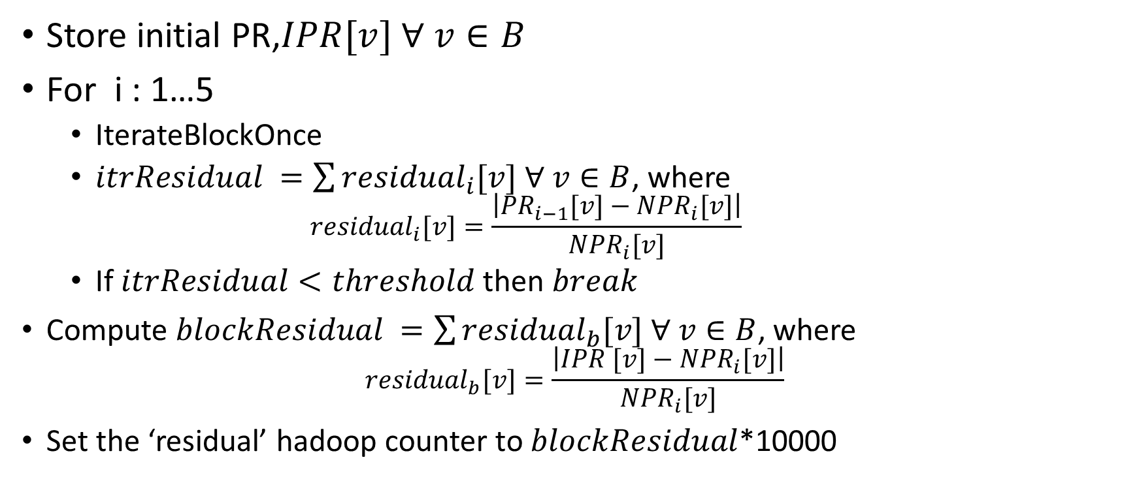
Reducer Pseudocode
Store initial PR,$IPR[v] ∀ v∈B$
For i : 1…5
IterateBlockOnce
$itrResidual =\sum{{residual}_{i}[v] ∀ v∈B}$, where
$${residual}_{i}[v]=\frac{\left|{PR}_{i−1}[v]−{NPR}_{i}[v]\right|}{{NPR}_{i}[v]}$$
If $itrResidual<threshold$then $break$
Compute $blockResidual =\sum{{residual}_{b}[v] ∀ v∈B}$, where
$${residual}_{b}[v]=\frac{\left|IPR [v]−{NPR}_{i}[v]\right|}{{NPR}_{i}[v]}$$
Set the ‘residual’ hadoop counter to $blockResidual$*10000

